Slide 1

CEIR Register Device Feature -Training Manual

Slide 2

Agenda
Feature
Stakeholder
State Diagram
UI Walk Thru
Manage User
Manage Device

Slide 3

Feature Overview
Register User Feature allows end user to register their devices in the CEIR system
This feature is also extended to immigration and custom department to register the device in case end user does not do so.
Typical flow is as follows:
End
User
Custom Department
Immigration
User
Register Device
End user register device in the CEIR portal
CEIR Admin approve the request
Custom official register device in the CEIR portal
CEIR Admin approve the request
Immigration personnel register device in the CEIR portal
CEIR Admin approve the request
CEIR System

Slide 4
Register Device – Overview – End User
Using this feature, user/immigration/Customs can register their devices in the network.
User can be a foreigner or National user
VIP should also register the devices in the network
As part of registration process, user will share the following information
Personal Details (Name, Contact, Address)
Device Details (Device Type, IMEI, Multiple SIMs) for 1 or more devices
Travel Details (only for foreigner). Based on visa details, the number is added in the temporarily whitelist
Post registration,
National User to pay taxes with custom department
Foreign user can buy local SIM and start using the device, if count of registered device is less than permissible limit
Foreign user to pay taxes with custom department, if count of registered device is less than permissible limit

Slide 5
Register Device (Contd…)
Devices are de-registered once the visa expiry has happened
Remove from temporary whitelist DB
No need to register, if foreigner intend to use foreign SIM in the device
If the national user is registering the devices, it is considered to be added in whitelist permanently once taxes are paid.

Slide 6
Register Device (End User– National User)

Slide 7
Register Device (End User – Foreigner User)

Slide 8
Register Device (Custom – National User)
This flow is common for both foreigner and local Cambodia user. Both of them visit the custom to pay taxes

Slide 9
Register Device (Immigration – Foreigner User)
If end user has registered the device on its own, then there is no role of immigration department.

Slide 10
Feature Impact / Use Cases
Importance of this feature for the CEIR System
Creation of whitelist based on the device registration by end user/customs/immigration officials.
Collection of taxes from local Cambodian user and foreigner

Slide 11
Stakeholder Overview

Slide 12
State Transition – Overview – Register Device – Immigration/Custom
Immigration/Custom
System
CEIR Admin
Register Device Request State under various Stakeholder
NEW
PROCESSING
Pending for CEIR Approval
Approved
Register
Device
Request
System
Process
System
Process
Approve
System
Process
Reject
Rejected by System
Rejected by
CEIR Admin
Device State under various Stakeholder
INIT
Pending
ACTIVE

Slide 13
State Transition – Overview – End User
End User
System
CEIR Admin
Approved
Stolen Request State under various Stakeholder
NEW
PROCESSING
Pending for CEIR Approval
Register
Device
Request
System
Process
System
Process
Approve
System
Process
Reject
Rejected by System
Rejected by
CEIR Admin
Device State under various Stakeholder
Blocked
Pending
Active

Slide 14
State Transition - Overview

Slide 15
Register Device - Scenarios
Temporary Whitelist – Foreigner
Permanent Whitelist – Customs
First Time
End User Register device
Immigration Register device.
Second Time
Travelling on Old Visa which is already configured but with new device
Travelling on New Visa and carrying old device which is already registered
Travelling on New visa and carrying new device
First Time
End User Register Device
Custom Register Device
Second Time
User is already registered and new device

Slide 16
UI – Overview - Feature

Slide 17
Action List
Action are enabled / disabled based on the state of the request.

Slide 18
Actions Enabled/ Disabled for User

Slide 19
Register Request - Flow
End User want to register a device .
In order to register a device, a End User needs to furnish the following details:
Device Information
Personal Information
A unique Transaction ID is generated for each new request which is registered. This transaction id can be used in future for raising grievance (if any) regarding the request. The transaction ID will be used for tracking the reqeust at any state.
System processing is being done at the backend. Status = PROCESSING
In case the request is rejected by system. Status = REJECTED BY SYSTEM
System rejects the request in case there is some issue with the format of the file uploaded or any policy violation is done. The format of the file is available for download on the view all screen.

Slide 20
Register Request Flow ( contd..)
After successful internal processing, the request is sent to the CEIR Admin queue for Approval/ Rejection. Status = PENDING APPROVAL FROM CEIR ADMIN.
CEIR Admin rejects the request. Status = REJECTED BY CEIR. Email is sent to End user. CEIR Admin can also withdraw request. Status = WITHDRAWN BY CEIR.
CEIR Admin approves the request. Status = APPROVED. Email is sent to End User.

Slide 21
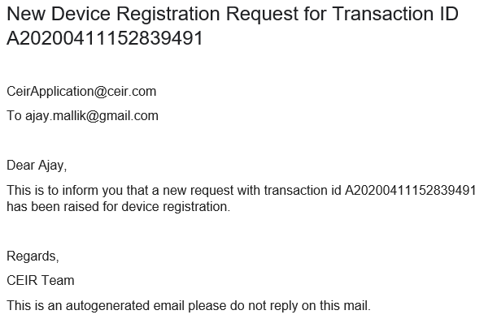
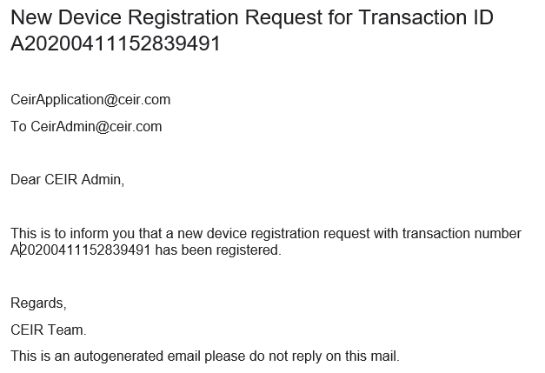
Email samples
Email sent to CEIR Admin
Email sent to User

Slide 22
System Processing
All NEW request will be processed in FIFO order by the system
Once the processing starts, the status is changed to PROCESSING to indicate that Work is in progress
Once the processing is complete, the status is changed to either REJECTED_BY_SYSTEM or SUCCESS (PENDING_APPROVAL_FROM_CEIR_ADMIN)
Post processing an e-mail notification is sent to User in case of REJECTED_BY_SYSTEM and in case of SUCCESS email is sent to both End User and CEIR Admin.

Slide 23
System Processing – Register Device Case
If request has been processed successfully for register device request, then the IMEI is added in the whitelist
If request has not been processed successfully for register device request, then the request is rejected.

Slide 24
Export Register Device Request
Requests can be exported in a .csv file using the export button.
User can export all request assigned to the respective user.
User can export filtered requesst.

Slide 25
Policy
Policy for grace and post grace period will be same for register devices
More details on same would be discussed in the “Policy Management” Training session

Slide 26
Whats Next
Once the whitelist is created in the system, the same is allowed to be used in the network.
Whitelist is temporary or permanent.
In case of temporary number, then number are deleted once the visa expires

Slide 27
Queries

Slide 28
Thank You

